Slide 1
Optimal Control for Generalized Network-Flow Problems
Abhishek Sinha, Eytan Modiano
LIDS, MIT
INFOCOM, 2017

Slide 2
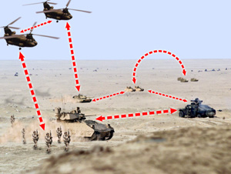
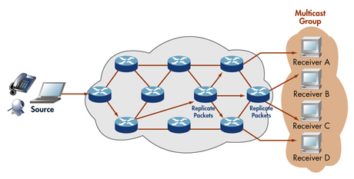

Motivation
Broadcast
Multicast
Unicast +
Broadcast +
Anycast +
Multicast

Slide 3
Introduction
We consider the Generalized Flow Problem
Packets may belong to different concurrent sessions including unicast, broadcast, multicast or anycast.
A fundamental problem with numerous applications
No efficient and throughput-optimal algorithm is known apart from the unicast problem (Backpressure algorithm [Tassiulas et al ’92], [Sarkar et al, ‘02], [Georgiadis et al., ‘06]).
Packet duplications make the problem hard (no flow conservations)
Our contribution: An efficient algorithmic paradigm that solves all flow problems with enhanced delay performance.

Slide 4
System Model
Multi-hop wireless network
Only a subset of the links may be activated simultaneously, due to interference
Stochastic arrivals – i.i.d. process with arrival rates for flow c
The vector is unknown in advance
Time-slotted system
λ₁₂ , λ₁₄ , λ₁₆
1
4
3
λ₂₁ , λ₂₄ , λ₂₈
2
λ_{6i} , ...
6
5
7
8

Slide 5
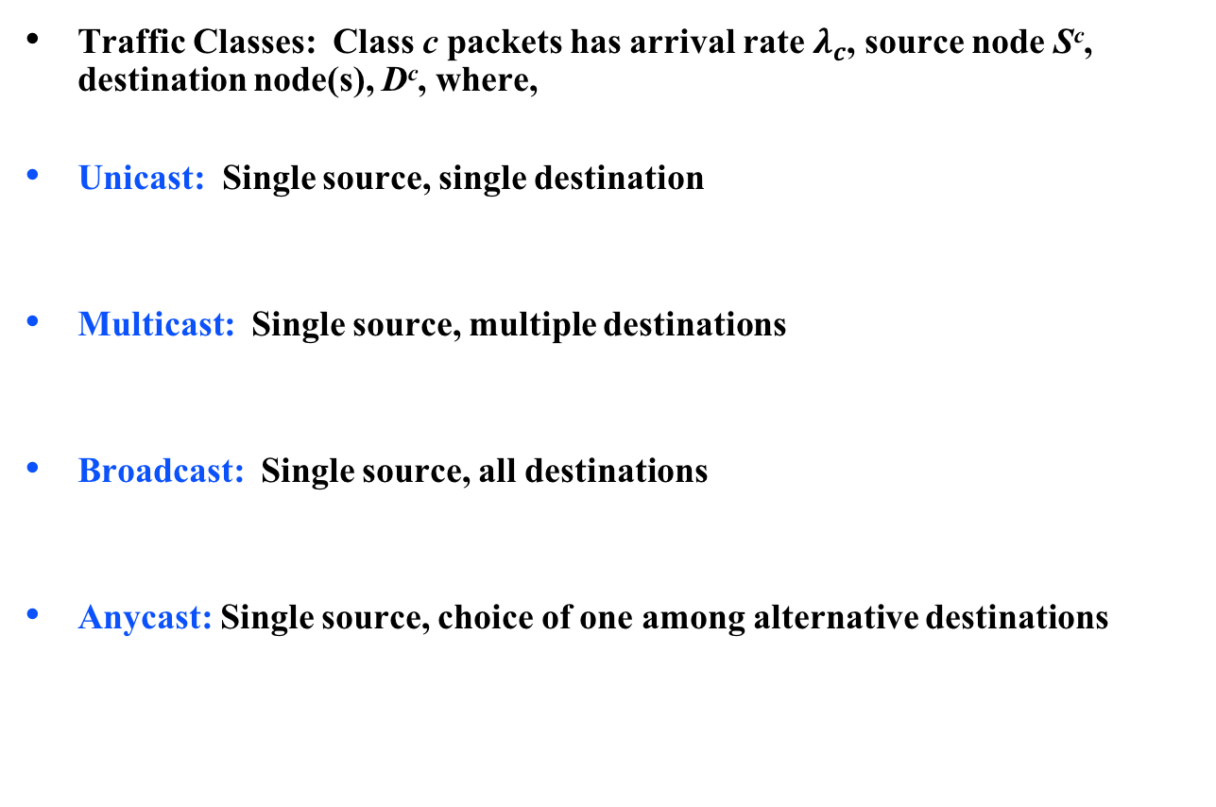
Traffic Model: Generalized Flow
Traffic Classes: Class c packets has arrival rate $λ_{c}$, source node S^{c}, destination node(s), D^{c}, where,
Unicast: Single source, single destination
Multicast: Single source, multiple destinations
Broadcast: Single source, all destinations
Anycast: Single source, choice of one among alternative destinations

Slide 6
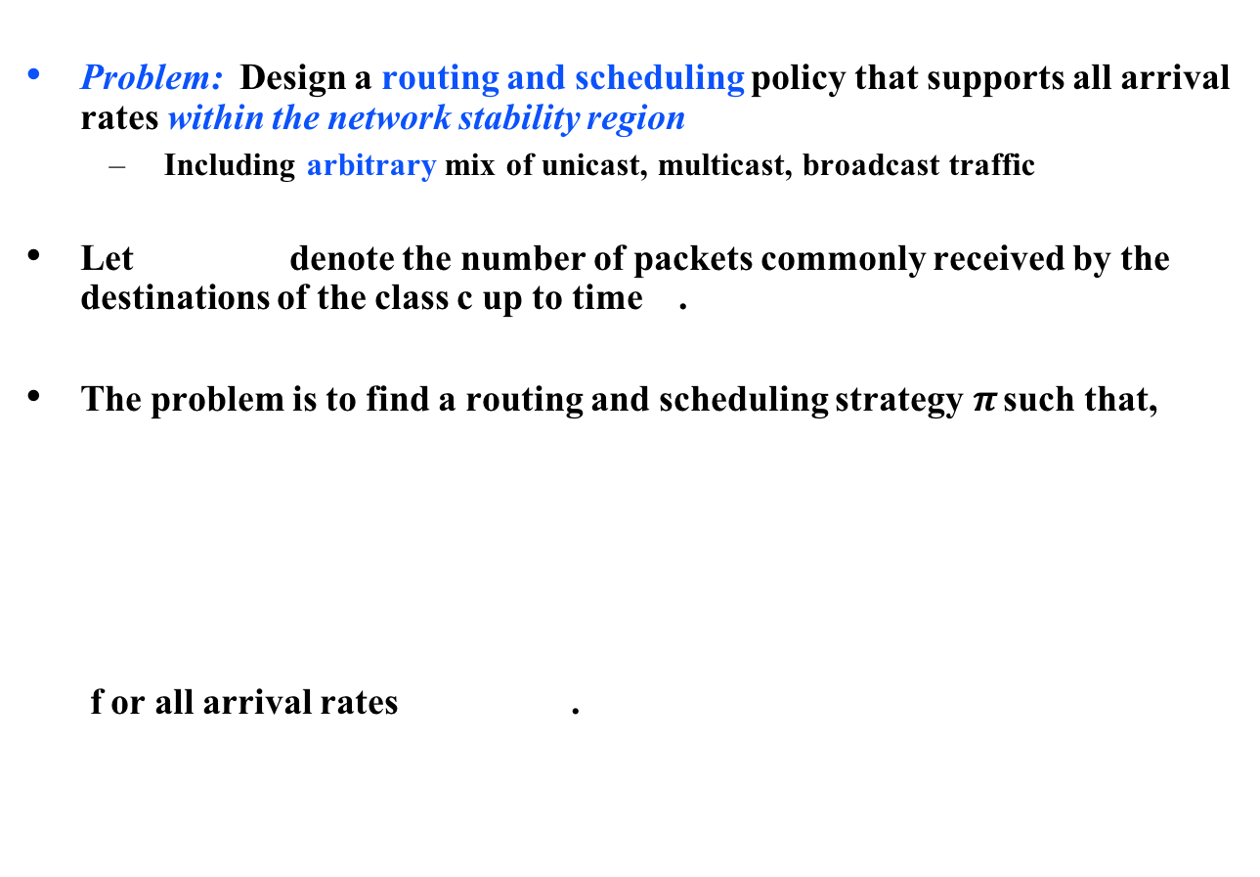
Formal Problem Statement
Problem: Design a routing and scheduling policy that supports all arrival rates within the network stability region
Including arbitrary mix of unicast, multicast, broadcast traffic
Let denote the number of packets commonly received by the destinations of the class c up to time .
The problem is to find a routing and scheduling strategy$π$ such that,
f or all arrival rates .

Slide 7
Routing and Link Scheduling: Example
Example – primary interference
7
6
6
6
6
1
6
4
7
3
7
6
7
2
6
7
8
6
6
7
7
7

Slide 8
Overview of UMW
UMW solves the generalized flow problem which includes Unicast, Broadcast, Multicast and Anycast
Compared to the Backpressure Policy (BP), which solves only Unicast
UMW dynamically chooses routes for each packet at the source (source routing)
Compared to BP, which makes hop-by-hop routing decision
Routing and Scheduling actions of UMW are oblivious to the physical queues and depends on virtual queue-lengths which corresponds to a simpler precedence-relaxed system
Compared to BP whose actions depend on physical queue-length differentials
UMW uses solution of standard combinatorial problems (e.g., Shortest path, MST, min-cost Steiner Tree etc.) as a subroutine

Slide 9
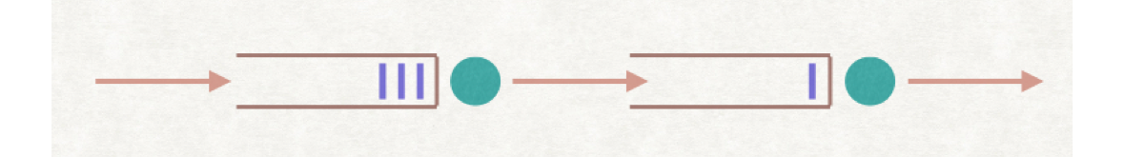
Design of UMW: Challenges and Insight
Due to interdependent arrivals, networked queues are harder to analyze and control
We obtain a simpler virtual system of queues by relaxing the Precedence constraints as described next
Link 1
Link 2
Source
Destination
iid arrivals
correlated arrivals

Slide 10
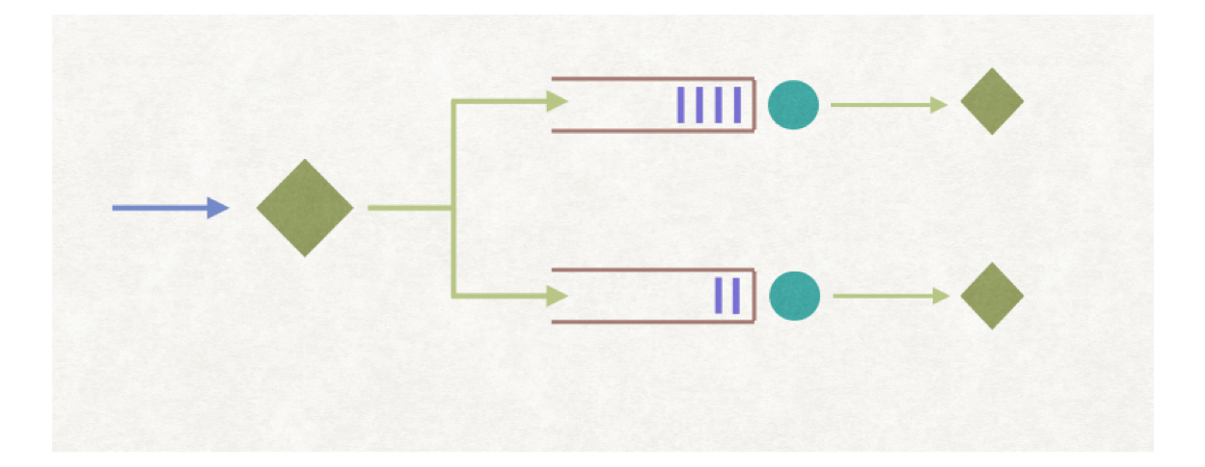
Precedence Relaxed System
As an example, consider a two-hop network
The packet p must traverse Link 1 before crossing Link 2 (Precedence)
Equivalent virtual queue system
Packet arrives to both queues simultaneously (No precedence constraint)
Link 1
Link 2
p
p
p
p

Slide 11
Virtual Queueing System : Operation
Associate a virtual queue with each link in the network
Upon packet arrival:
Determine a route (e.g., path, tree etc.) for the packet
Immediately inject a new packet to each virtual queue along the route
Packets are served from the virtual queues as long as the corresponding virtual queues are non-empty
Subject to the scheduling constraints
Don’t care whether the physical queues are empty or not
Question: How to design the optimal routing and link scheduling policy?

Slide 12
Virtual Queue Operation : Unicast Traffic
Unicast arrival from a – d
Chosen path a-c-d
Virtual Arrival to Qac and Qcd
Virtual Queues
Qab
b
Qbd
a – d
a
d
+1
Qac
c
+1
Qcd
Qbc

Slide 13
Virtual Queue Operation : Broadcast Traffic
Broadcast arrival
Chosen tree: a-b-c-d
Arrival to Qac, Qab, and Qcd
Virtual Queues
+1
Qab
b
Qbd
p
a
d
+1
Qac
c
+1
Qcd
Qbc

Slide 14
Dynamics of the Virtual Queues
Define the controlled arrival vector to the virtual queue to be
where the controlled variable denotes number of virtual packet arrival at the virtual queue at time t
Let be the (controlled) departures from virtual queue at time t
The virtual Queues evolve according to the Lindley recursions:
Unlike the original system, given the controls, the virtual queues are independent of each other, making their control and analysis tractable

Slide 15
Optimal Control: Stabilizing the Virtual Queues
Our next step is to design a control policy stabilizing the virtual queues
The policy consists of routing decisions: virtual queue arrivals and scheduling (link activation) decisions: virtual queue departures
Intuition: This control is likely to stabilize the physical queues as well
However, the dynamics of the physical queues depends explicitly on the physical packet scheduling policy (e.g., FCFS, etc.)
To stabilize the virtual queues, we choose a control which minimizes the drift of a Quadratic Lyapunov Function of the Virtual Queues

Slide 16
Derivation of the VQ Stabilizing Policy
Define a Lyapunov function quadratic in the virtual queue lengths
The one-slot drift of under policy is given by,
where and are respectively routing and activations chosen by the policy
The drift upper-bound has a nice separable form and may be minimized over the feasible controls separately

Slide 17
Optimal Control: Routing
Minimizing the upper-bound on drift over the routing action, we get the following general route selection policy at time t
Special Cases:
Unicast: Shortest path in the weighted graph
Broadcast: Minimum weight Spanning Tree in
Multicast: Minimum weight Steiner tree in , connecting the source node to the destination nodes
Anycast: The Shortest of the all paths in the weighted graph

Slide 18
Routing in the Virtual Network (Unicast)
Virtual Queues
Qab =10
b
10
15
Qbd=15
a
7
d
+1
Qac=5
5
c
8
+1
Qcd=8
Compute the Shortest Path
weighted by Virtual Queues
Qbc=7

Slide 19
Routing in the Virtual Network (Broadcast)
Virtual Queues
+1
Qab =10
b
10
15
Qbd=15
a
7
d
+1
Qac=5
5
c
8
+1
Qcd=8
Compute the MST
weighted by the Virtual Queues
Qbc=7

Slide 20
Optimal Control: Link Scheduling
Similarly, minimizing the upper-bound drift for link-scheduling actions, we get the following activation policy:
(Max-Weight activation, using virtual queue length)
Example: For wireless networks with Primary interference constraints the above problem reduces to finding a Max-Weight-Matching in the weighted graph
b
10
15
a
7
d
5
c
8

Slide 21
Theorems: Virtual Queue Stability
Theorem [Strong Stability of the VQs]: Under the UMW routing and link scheduling scheme, the VQs are strongly stable:
This leads to the following sample path result:
Theorem [Almost sure bound]: Under UMW the VQs at time t are bounded as follows

Slide 22
Packet Scheduling for Physical Network
The Same Routing and Scheduling Policy used as in the Virtual Network.
How do we decide which packet to transmit over a link at any given time slot?
Why does it matter? Can’t we just use FCFS?
Extended Nearest to Origin policy (ENTO): When multiple packets contend for an edge, schedule the one which has traversed the least number of edges
Extension of NTO (Gamarnik, ‘98) for an adversarial setting
Theorem [Stability of the Physical Queues] : The overall UMW policy is throughput-optimal.

Slide 23
Extended NTO : Example

Slide 24
Proof of Stability of the Physical Queues
Stability of the VQs imply arrival rate to any physical link is less than the allocated service rate
Generally not enough for proving stability
The complete stability proof relies on a result from adversarial queueing theory [Gamarnik ‘98] for wired networks under NTO policy
We extend the proof to the wireless setting with ENTO
Sample path argument
Induction on the number of packets that are k-hops away from the origin:
We show that the number of packets that are one hop away from origin is bounded, then use the condition from previous slide to show that the same holds for packets two hops away, etc.
Details are in the paper

Slide 25
Generality of the VQ approach : Recent Results
Recently (MobiHoc’17) we developed an optimal broadcast policy for wireless networks with point-to-multipoint links
Unlike the point-to-point broadcast, we prove that the combinatorial version of this problems is NP-hard
Here VQs are associated with each node and we need to solve the Minimum Connected Dominating Set problem for routing

Slide 26
Analysis of the Physical Queues - I
Lemma: The virtual queues are almost surely rate-stable, i.e.
Hence for sample paths with , we have the bound
for some function
The above result enables us to analyze each sample path of the set separately and forms the key to our stability analysis of the physical queues.

Slide 27
Analysis of the Physical Queues - II
For any edge define the cumulative arrival and service processes in the interval at the virtual queue as follows:
By the above definition, denotes total number of packets that have been injected into the virtual queue in the time interval .
However, from the description of UMW, this is exactly equal to the number of physical packets that have been injected into the network in the time interval that wish to cross the edge e in future. Denote this quantity by .
The same conclusion holds for the cumulative service process .

Slide 28
Analysis of the Physical Queues - III
Using Theorem 1, the previous observation and Skorokhod Maps for the virtual queues, we obtain the following:
Theorem 2 : Almost surely for all sample paths , there exists a non-negative function such that for any the following holds for all physical queues:
The previous theorem informally states that the rate of arrival of packets at any edge is at most the rate of service offered to the edge almost surely, under the operation of the UMW policy.
Theorem 3 : Physical Queues are Rate Stable under ENTO.

Slide 29
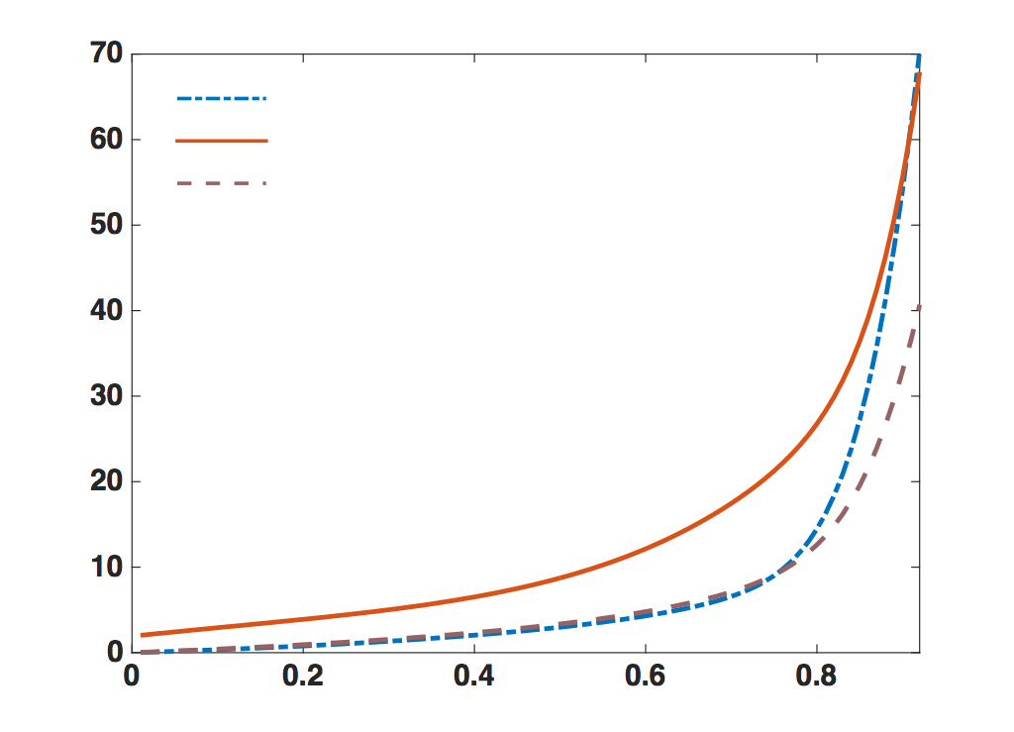
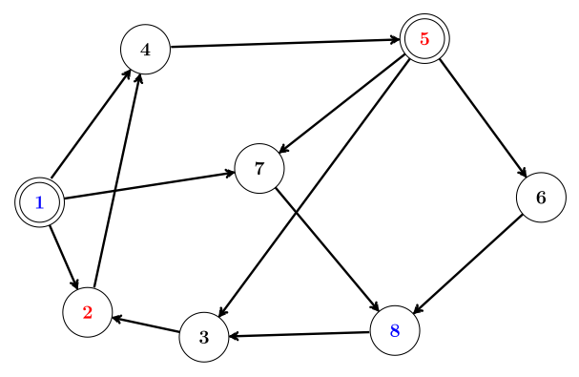
Simulation Results (Unicast)
UMW with virtual Queues
BP
UMW with Phy. Queues
Delay
Load Factor
Two Unicast flows : 1 to 8 and 5 to 2

Slide 30
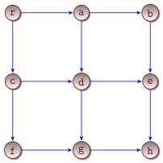
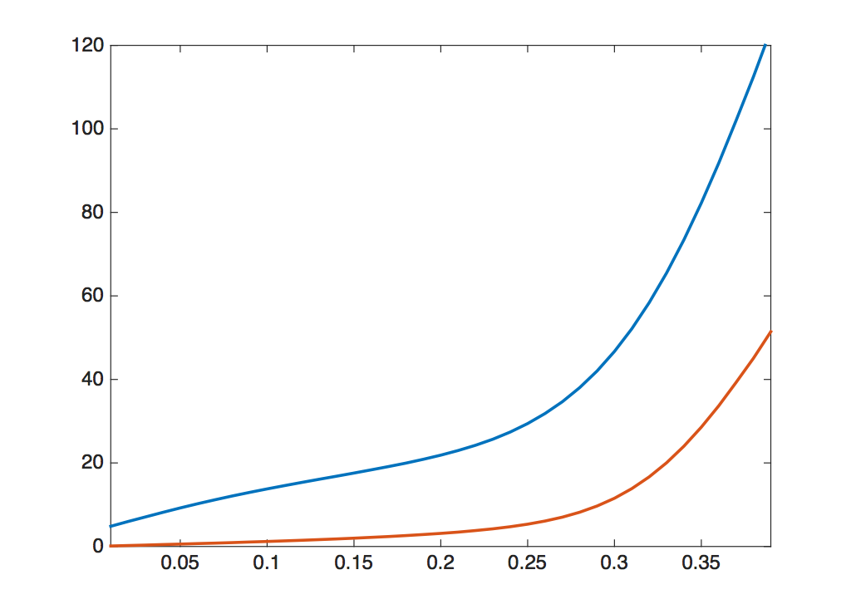
Simulation Results (Broadcast : Static Network)
UMW with
Virtual Queues
UMW with
Phy. Queues

Slide 31
Simulation Results (Broadcast: Time-varying Network)

Slide 32
Conclusion
Our understanding of network control theory has progressed enormously over the past 25 years, starting with the seminal work of Tassiulas et al. in 1992.
Universal-Max-Weight (UMW) is throughput optimal and can be used in a wide range of network flow problems
UMW, specialized to unicast, gives better delay performance over the classical Back-Pressure algorithm
Open Problem: Does the proposed algorithm remain optimal when used in conjunction with the Physical Queue lengths, instead of the virtual queue-lengths ?
Empirical evidence suggest yes
Leads to a more efficient distributed implementation of UMW

